Slide 1
Program to generate and implement sequence generator
the sequence generators are nothing but a set of digital circuits which are designed to result in a specific bit sequence at their output. There are several ways in which these circuits can be designed including those which are based on multiplexers and flip-flops. designing of sequence generator using D flip-flops.
We have used 3 flip-flops to generate the sequence
The sequence we generated:0011101
Initially giving the inputs s1,s2,s3 as 100 and
Using bitwise exclusive or to get so=s1^s3
And in every step making s1=so , s2=s1, s3=s2
and printing the output bit s3

Slide 2
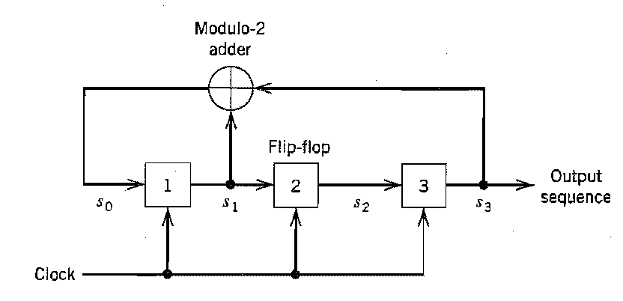

Slide 3
